Slide 1
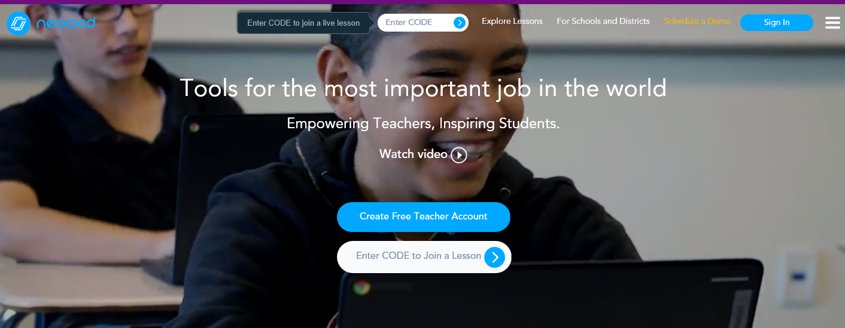
Introduction to Nearpod

Slide 2
Learning Objective
To create, amend, present and review Nearpod activities

Slide 3
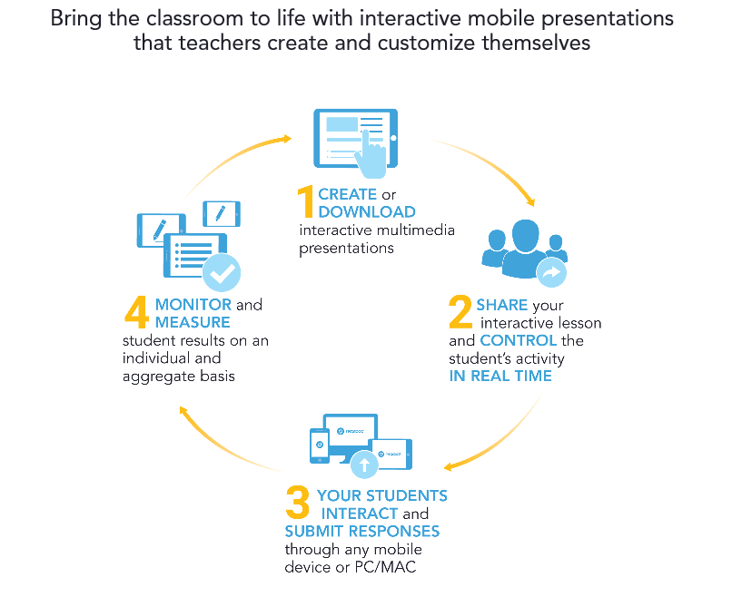
What is nearpod?

Slide 4
Nearpod video- Education Tools for the Most Important Job in the World

Slide 5
Nearpod demonstration

Slide 6
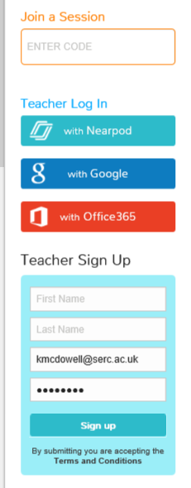
Create A nearpod account

Slide 7
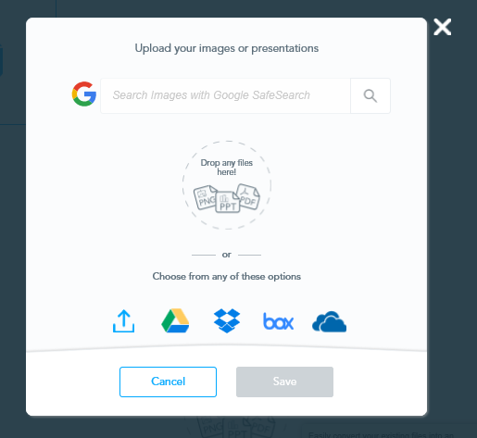
Import presentations

Slide 8
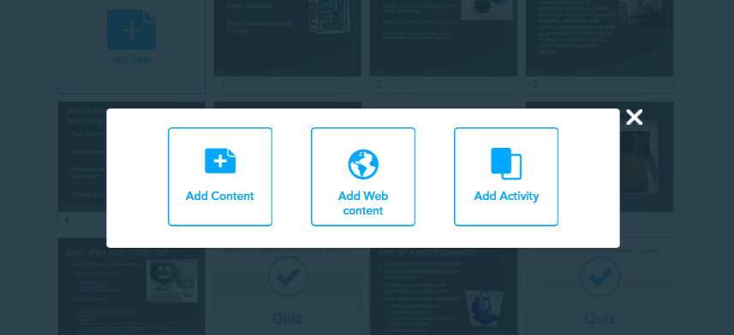
Add content and activities

Slide 9
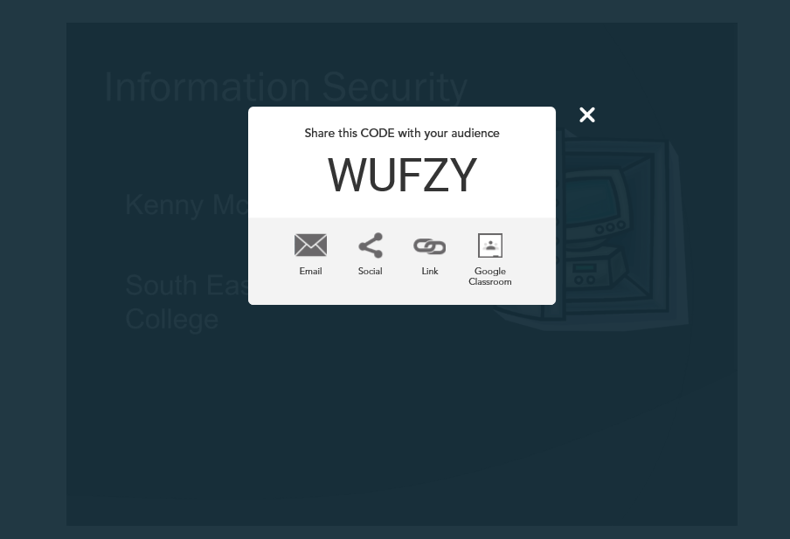
Run a quiz

Slide 10
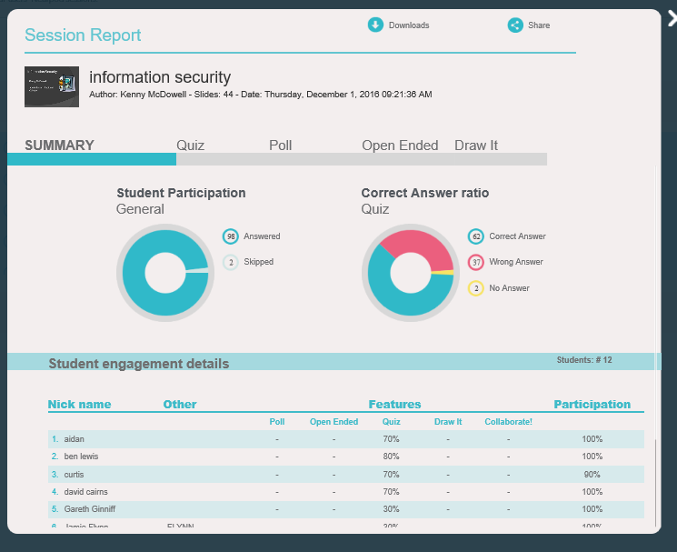
View results

Slide 11
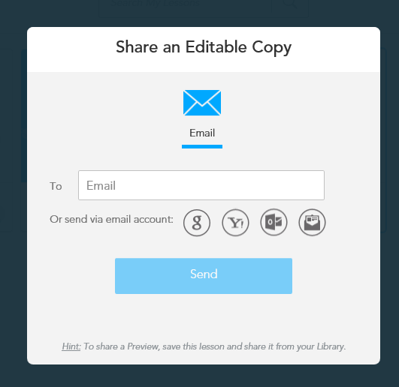
Share with others

Slide 12
Learning Objective
To create, amend, present and review Nearpod activities

