Slide 1
Tuesday 23rd May 2017 Technology Toolbox session 2 : Padlet

Slide 2
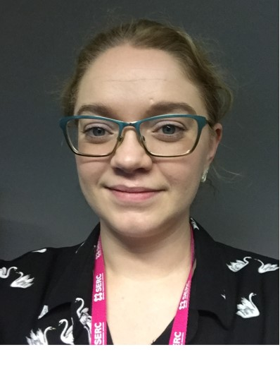
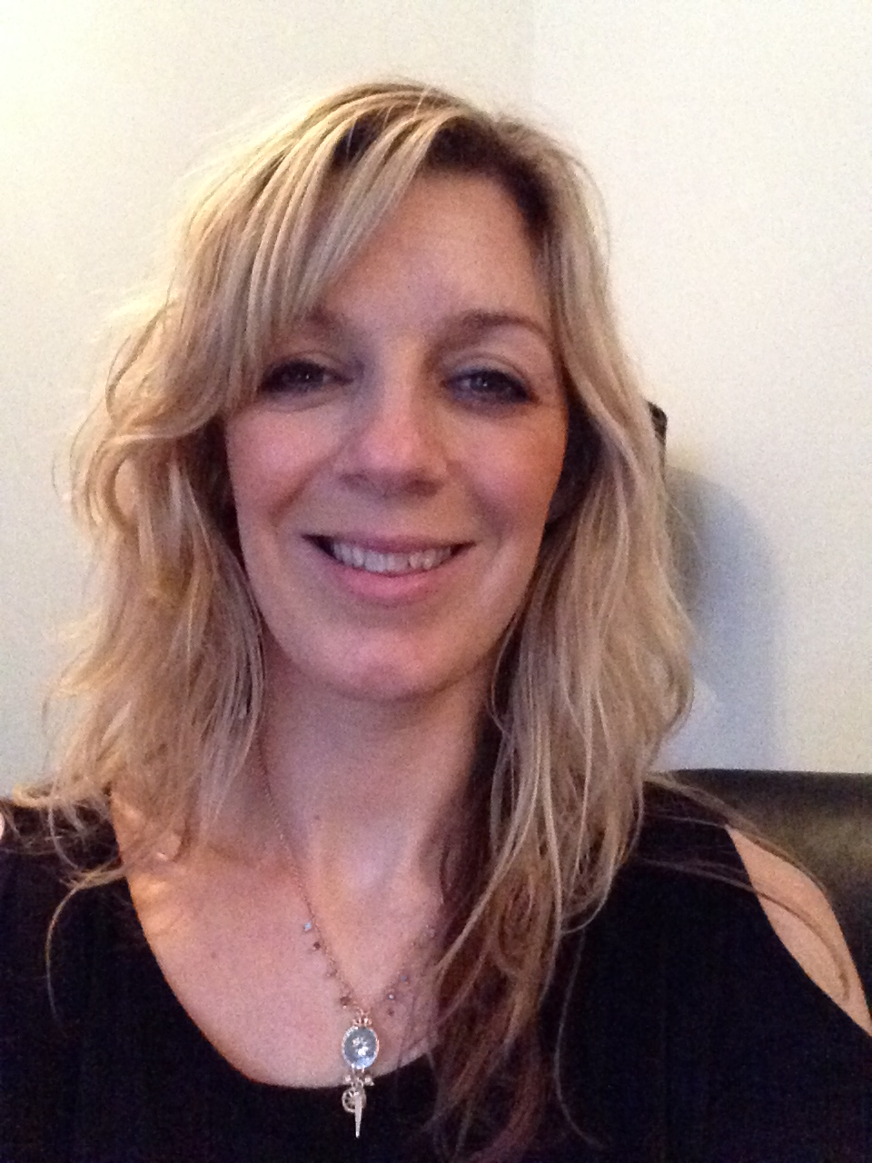
INTRODUCING……..Today’s Trainers…..
ILT Mentors
Nichola O’Hagan Stefanie Campbell

Slide 3
Guest access
Guest wireless network: Network: Guest
Password : coffeecup.
Log onto PCs with username: edu1
Password: password.

Slide 4
Intended Learning Outcomes
By the end of this session I will be able to:
Set up a Padlet account and create a Padlet Wall.
Post to my wall inserting pictures, text and video content.
Make 4 modifications to my wall.
Share my wall with a colleague.

Slide 5
Introducing Padlet
Padlet is an online virtual ’Notice’ board, where individuals can collaborate, share links, pictures and text securely.
Padlet walls are private and can be shared with a selected audience and given a custom URL.
Padlet posts can be moderated and removed hence its easy to manage your wall and have only the material you wish displayed.

Slide 6
Padlet – Free & Easy to use!

Slide 7
Advantages of Padlet
Free and easy to use.
Collaborative.
Secure with moderation.
Enhances shared learning.
Padlet is mobile – easy to access on smartphones!

Slide 8
Educational Advantages
Allows students to communicate and collaborate in a digital environment.
Students can post in many different ways.
Encourages active participation and allows students to post and receive feedback instantly.
www.ed.ted.com

Slide 9
A challenge with Padlet is that students can possibly share content that may be inappropriate, however this can be moderated.
Can be a distraction to learning if students take too much time adding ‘perfect posts’.
Walls are semi-private by default and a closer look is required.

Slide 10
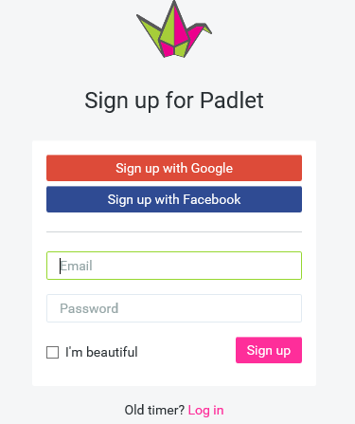
Lets get started!!!
Go to www.padlet.com

Slide 11
The Launching Pad - Dashboard
Simply click on Make a Padlet to create your wall!

Slide 12
Add content to your wall
Double click to add content (a post) to your wall.
You will notice that a box will appear (see top right) and a number of icons will be available.
These icons will enable you to add a variety of attachments.
Additionally, there is a little garbage can at the top right to allow for deletion.

Slide 13
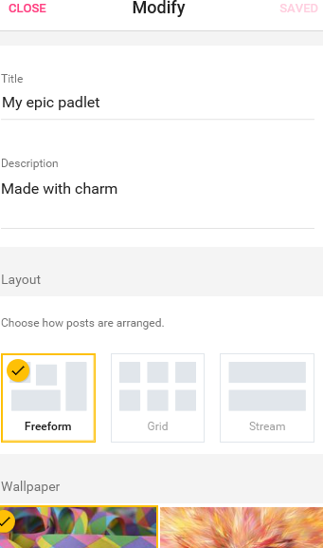
Modifications
Title
Description
Layout
Wallpaper

Slide 14
People & Privacy
A number of privacy restrictions can be applied.
These include keeping your Padlet private and not open to the public.
Having a password attached to a Padlet Wall and even hiding the wall altogether, perhaps if it is under construction.

Slide 15
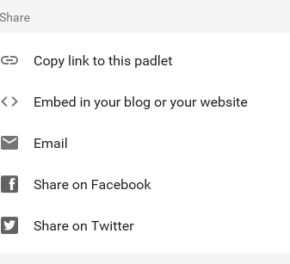
Share
Padlet can be shared in the following ways:

Slide 16
Intended Learning Outcome - Recap
Was I able to?
Set up a Padlet Account and create a Padlet Wall.
Post to my wall inserting pictures, text and video content.
Make 4 modifications to my wall.
Share my wall with a colleague.

Slide 17
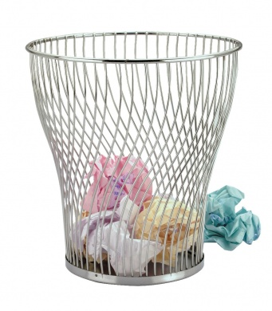
Treasure chest / Wastepaper basket !

